Slide 1



Slide 2
About today…
React.js
State Management
Hooks
useState Hook

Slide 3

Objective
Understand what state is and why it's important in React applications

Slide 4
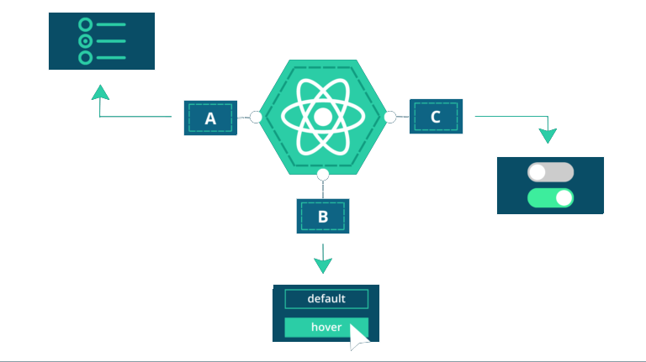
Introduction to React State Management
Definition
State is a way to store and manage data in a component
Importance
State allows React components to remember information and respond to user actions

Slide 6


Hook
Special functions introduced in React 16.8
Allow to use state and other React features without writing a class
Enable to manage state and lifecycle methods in functional components
Make code more modular, readable, and easier to test
useState
useEffect
useContext
useRef
useReducer
useCallback
useMemo
Hooks can only be called inside React function components
Hooks can only be called at the top level of a component
Hooks cannot be conditional

Slide 7
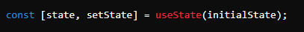
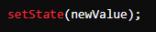
useState Hook
Initialization
Declare state variables using the useState hook
Updating State
Use the state updater function to change the state

Slide 8
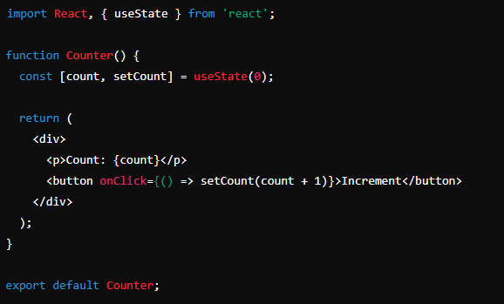
Example : useState Hook

Slide 9

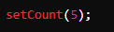
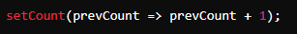
State Update Patterns
Direct Update
Simple state update with a new value
Functional Update
Use the previous state value for the update

Slide 10
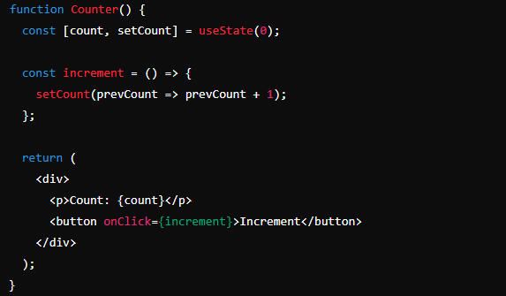
Example : State update

Slide 11
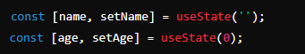
Handling Multiple State Variables
Manage multiple state variables in a functional component
Multiple State Declarations
Use multiple useState calls for different state variables

Slide 12
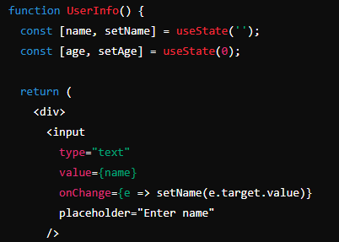
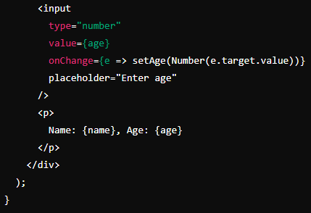
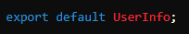
Example

Slide 13

Best Practices in State Management
Keep State Minimal
Only store what you need
Avoid Direct Mutations
Always use the state updater function
Structure State Logically
Group related data together
Directly modifying state variables instead of using the updater function
Storing derived data in state instead of computing it on the fly

Slide 14


Slide 15

What is the purpose of state in React components?
Which hook is used to manage state in functional components?
How do you update the state in React using the useState hook?
What is the correct way to handle multiple state variables in a functional component?

Slide 16

Task 1
Create a user component that shows the stored username by taking it from state variable
Task 2
Create a counter component which increments value when “+” button is pressed

